Slide 1
Funding Landscape
Public Markets
Private
Equity
Key:
Venture Capital
Equity
Private Debt / Bank Lending
Debt
Grants
Investment Value
Grants
Angels
Innovation Loans
Friends/Family
Founder’s Funds
Concept
Development
Pre-commercial
Early Commercial
Scale
Source: BBB & Innovate UK
Notes:
Grants = “Free Money”
Debt = “Money you have to pay back”
Equity = Share of the company + Money you pay back + …..

Slide 2
NI Funding Landscape
Public Markets
Private
Equity
Key:
Equity
Private Debt / Bank Lending
TechStart
Clarendon
Whiterock
Debt
Grants
Investment Value
InvestNI
Catalyst
Ormeau Lab
HBAN
Enterprise NI
Whiterock
Friends/Family
Founder’s Funds
Concept
Development
Pre-commercial
Early Commercial
Scale
Source: BBB & Innovate UK
Notes:
Grants:
InvestNI/DfE = Innovation Vouchers; Grant for R&D; +52 others through NIbusinessInfo - https://www.nibusinessinfo.co.uk/business-support
Catalyst = Invent (Prize Fund); Co-Founders (£10k)
Ormeau Labs = Offices +£50k convertible Loan note from TechStart
UK Gov listings. https://www.gov.uk/business-finance-support?
Innovate UK = Themed innovation grants (AI&Data; Clean Growth; Aging; Mobility) (£25k up to £10M https://www.gov.uk/business-finance-support/innovate-uk-grant-funding-innovation-loans-and-expert-support
Debt/Loans:
BBB StartUp Loans. Unsecured. https://www.british-business-bank.co.uk/finance-options/
Invest/DfE = Start-up Loans (up to £15k)
Invest/DfE = Small Business Loans (£10k-£100k)
Whiterock Capital = Growth Loan Fund (£100k-£500k) (ERDF)
Whiterock Capital = Growth Finance Fund (£32M) (BBB)
Funding Circle (Established businesses only: £350k unsecured; up to £1M secured)
Innovate UK = Themed innovation Loans £100k-£1M https://www.gov.uk/business-finance-support/innovate-uk-grant-funding-innovation-loans-and-expert-support
Equity Investors:
QUBIS
Innovation Ulster
TechStart (Techstart Ventures; TechStartNI dormant)
Clarendon (HBAN; CoFundNI) (HBAN mandate is moving to
Whiterock
BRCD (proposed)
Crescent (follow-on only?)
New BBB Regional Fund (2023)
BBB backed funds (https://www.british-business-bank.co.uk/ourpartners/enterprise-capital-funds/funds-we-have-invested-in/) (also Whiterock; Clarendon)

Slide 3

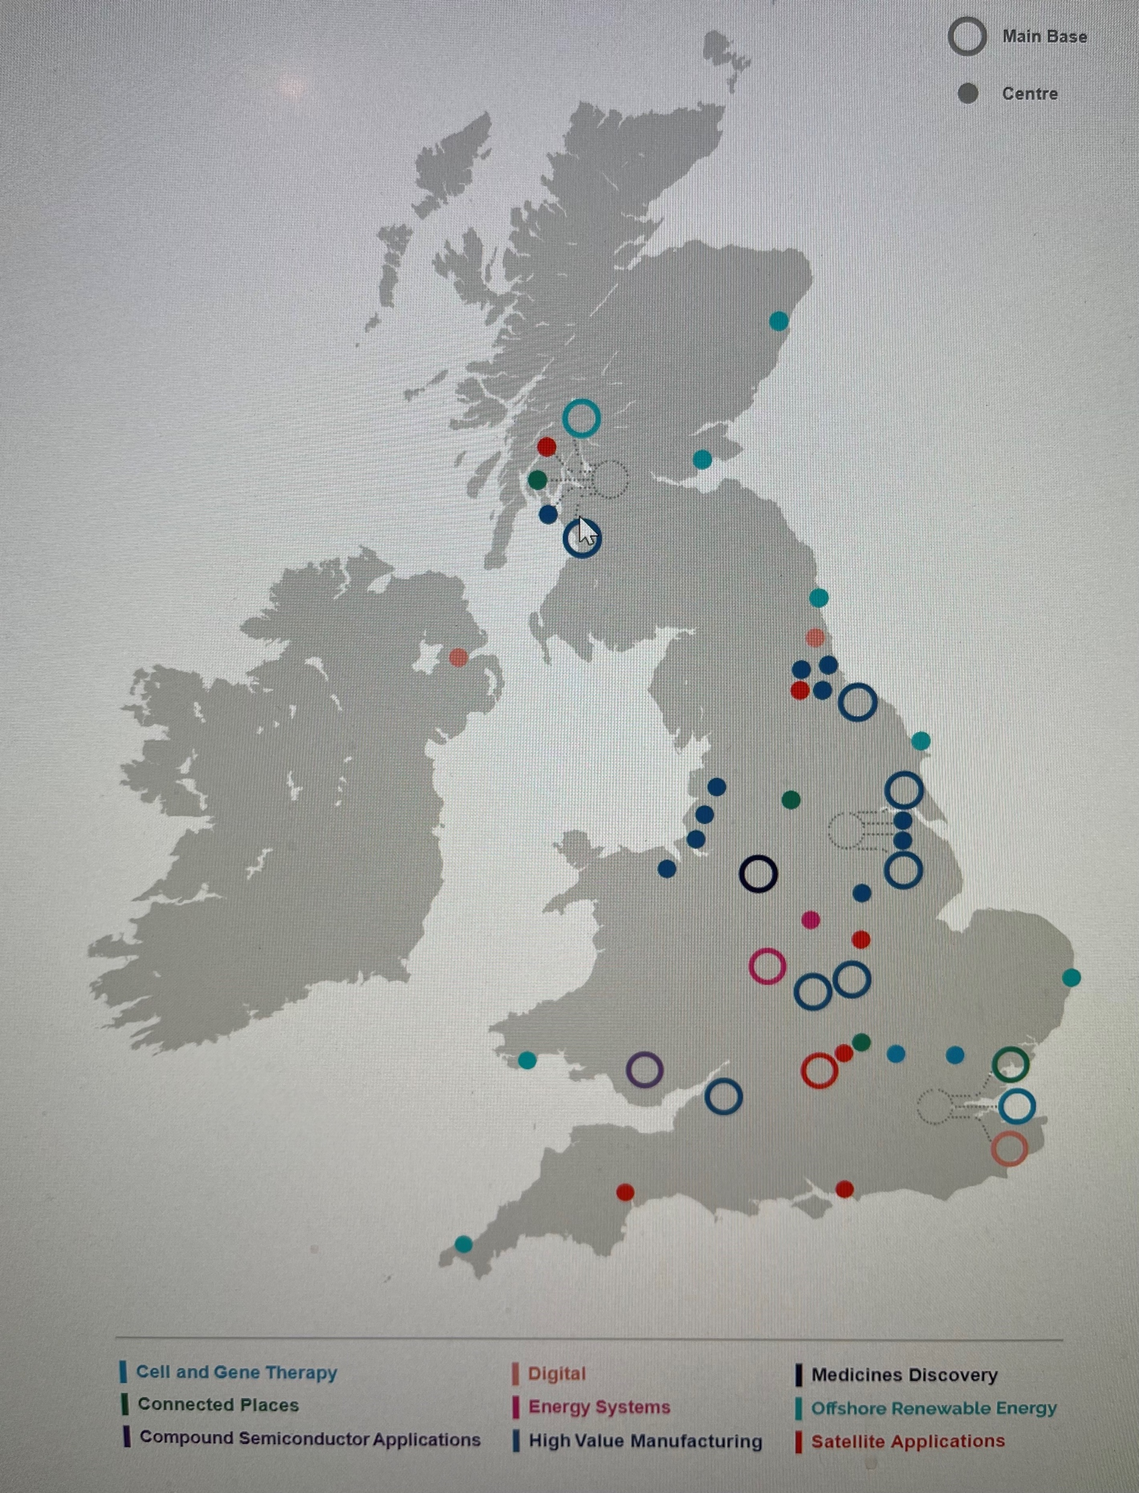
The UK R&D Funding Landscape and Catapult Network
Catapult Network
Catapults bridge the gap between research and industry. The 4,700 FTE strong Catapult Network is helping tackle the biggest challenges that society and industries face today. Through their knowledge, infrastructure and collaborations, Catapults make today’s industries more productive and create the markets of tomorrow.
1/3 core -1/3 CR&D -1/3 commercial model with £256m core funding pa
BEIS Funding Allocation
Source: Mark Gillan 2021

Slide 4


Innovate UK
Paul Malcomson
Manager Northern Ireland
Innovate UK

Slide 5


Innovate UK
We are the UK’s innovation agency
We support business-led innovation in all sectors, technologies and UK regions
A key delivery body of the Government’s Innovation Strategy
Our Mission
To help UK businesses grow through the development and commercialisation of new products, processes, and services, supported by an outstanding innovation ecosystem that is agile, inclusive, and easy to navigate.

Slide 6

Innovation
The lifeblood of business
Business innovation is the commercially successful application of ideas
Leads to the development of new or improved products, processes, services, and business models based on new ideas and technologies
Business innovation transforms existing sectors and stimulates new industries
It is key to UK growth and prosperity
Notes:
Innovation isn’t just the life blood of business, it is the engine of our social and economic recovery – and it’s key to the UK’s future growth and prosperity
Through business led innovation we can deliver delivers economic growth, new quality jobs and better living standards.
To innovate UK, innovation means the commercially successful development of new or improved products, processes, services, and business models based on new ideas and technologies
The UK is a great place to innovate and do business. It is home to world-leading scientists and to world-class businesses in sectors including aerospace, automotive, health, infrastructure and construction, manufacturing, agriculture and food, design and creative industries, high value services, and in the enabling and emerging technologies.
The government is committed to increasing total UK research and development investment (public and private) to £22 billion a year (equivalent to 2.4% of GDP) by 2027. We must ensure that the environment is right for the country to achieve this and for UK businesses to capitalise on the opportunities.

Slide 7
Inspire | Involve | Invest
Make the opportunity visible and compelling
Bring relevant organisations and people together
Convene the resources needed, including our own

Slide 8

Our Four Criteria
Large global market; accessible
Strong UK Capacity; relative
Timing; appropriate
Added-Value from our involvement

Slide 9











Our Priorities
Strategic Themes
Future Economy
Growth
at Scale
Global Opportunities
Innovation Ecosystem
Government Levers
Strong Foundations
Science & Research Strengths
Design
Expertise
Societal Impact & Responsible Innovation
Innovation Talent & Skills
Equality Diversity & Inclusion
Place & Levelling Up
Notes:
When you starting asking those appraisal questions, what answers do we get? Well, we think it looks like this...
We have identified five strategic themes - areas where we believe our efforts can have a significant impact on the returns the UK gains from business innovation.
We have also identified six strong foundations - these are both exploitable assets for businesses and cross-cutting, underpinning principles and behaviours that have a positive impact on business success and apply to all we do.

Slide 10


Guide our actions
Strategic Themes
Areas where our work can have a significant impact on the returns for the UK economy
The themes allow us to draw upon the UK’s established sector and technology expertise
Future economy
Growth at scale
Global opportunities
Innovation ecosystem
Government levers
Deliver purpose-driven programmes across net zero, health & wellbeing, priority technologies, and horizon scanning
Support businesses to develop their leadership, skills and commercial capabilities to scale up and attract investment
Enable businesses to build the global supply chains of the future, access markets and attract inward investment
Increase responsiveness, agility, and co-ordination to support innovating businesses from idea to commercialisation
Help stimulate innovation, through regulation, standards, intellectual property regimes, and public procurement

Slide 11
Political context for R&D
Spending Review commitment – “The government will ensure that an increased share of the record increase in government spending on R&D over the SR21 period is invested outside the Greater South East, and will set out the plan for doing this in the forthcoming Levelling Up White Paper.”
Levelling up white paper – “BEIS will aim to invest at least 55% of its R&D funding outside the Greater South East by 2024‐25.…….
UKRI a new organisational objective to “Deliver economic, social, and cultural benefits from research and innovation to all of our citizens, including by developing research and innovation strengths across the UK in support of levelling up”

Slide 12


Innovate UK regional team working to:
Strengthen relationships with key stakeholders – innovation/business support
Understand areas of strength and opportunities across academia and industry
Ensure coherent innovation strategy and investment across the UK
Working with stakeholders so that no grant applicant is disadvantaged because of their geography
Scotland
Bob Martin
Northern Ireland
Paul Malcomson
North East,
Yorkshire & Humber
Lee Viney
North West
Rick Holland
West Midlands
Nazia Iqbal
East Midlands
Julian Bowrey
East of England
Howard Partridge
Wales
David Cunnah
South East
and London
David Legg
South West
Layla Burrows
12

Slide 13
Key facts (Northern Ireland)
N
2014-2021 Northern Ireland received £160m of Innovate UK funding – 2.4% of all funding
Northern Ireland has the lowest amount of applications to Innovate UK – 1.4% of all applications
The aggregate success rate of Northern Ireland applications was 24% (joint rank 1 with Wales)
The number of applications and the size of applications is small.

Slide 14
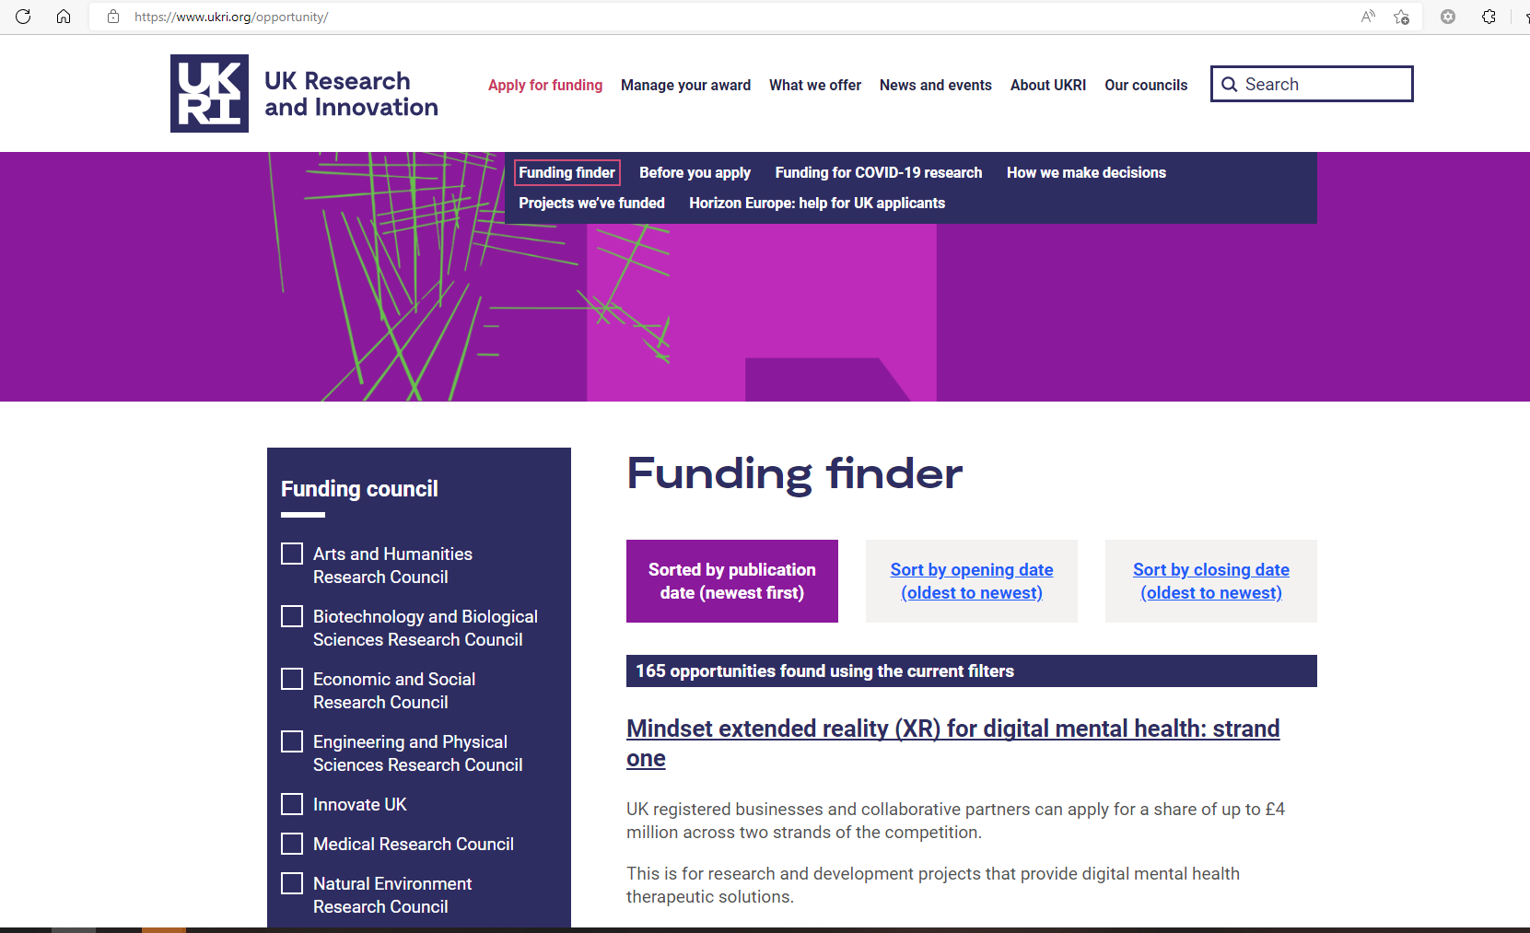
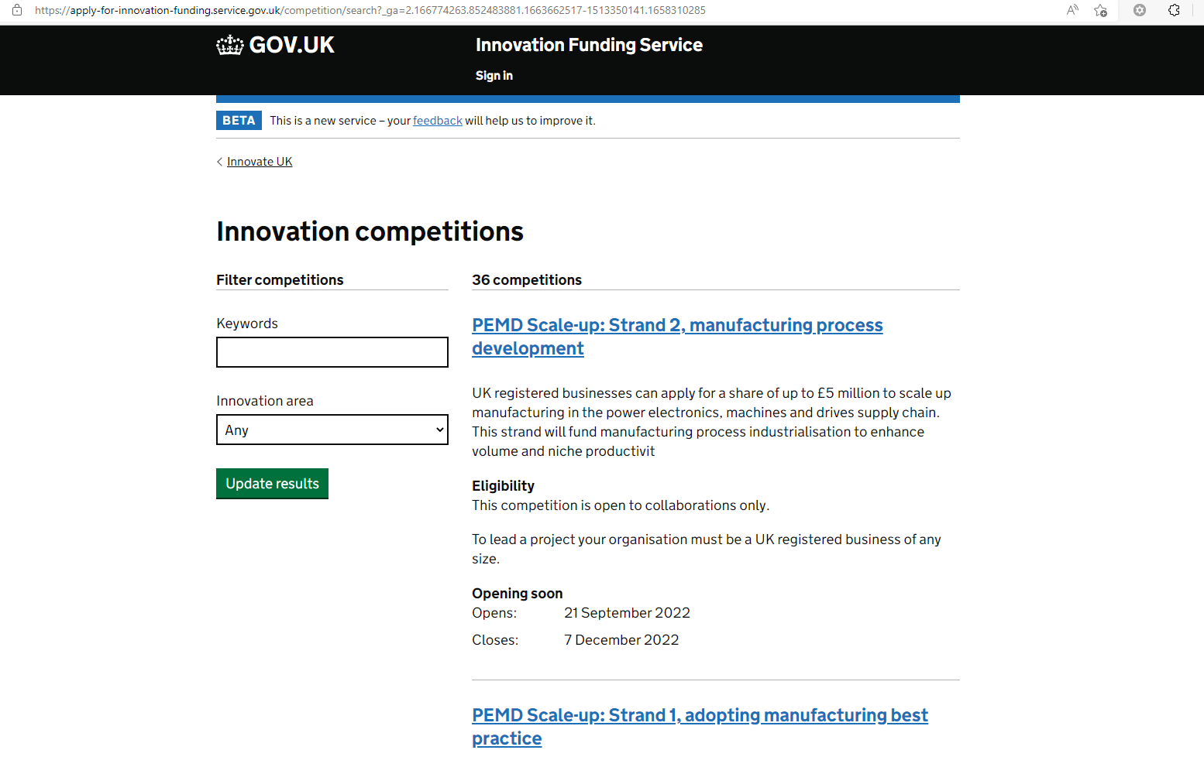
Live Funding Opportunities
https://www.ukri.org/opportunity/
https://apply-for-innovation-funding.service.gov.uk/
Notes:
NI Business Info; sign up IUK notifications, LinkedIn, etc.

Slide 15
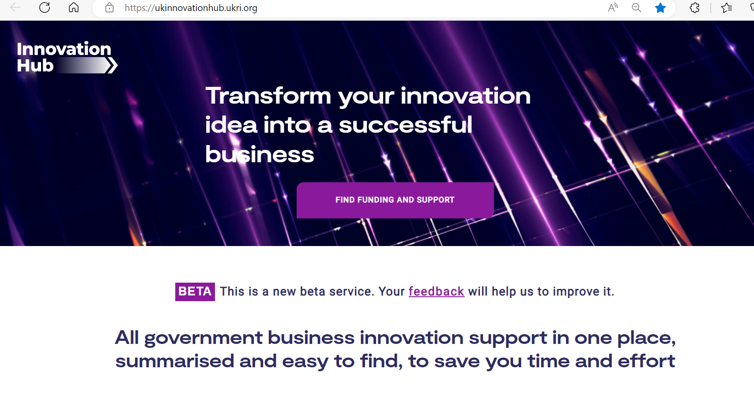
Live Funding Opportunities

Slide 16
The Catapult Network
A world-leading national capability
Supports businesses in transforming great ideas into valuable products and services.
Network of world-leading technology
and innovation centres
9 Catapults established by Innovate UK.
Independent non-for-profit organisations
Deliver impact across the UK economy, enabling businesses to thrive in global markets.
30 locations and expanding reach through partnerships with universities, all levels of government and a wide range of enterprise partners

Slide 17











Working in Partnership
Making it easier for businesses to go faster
Business innovation is difficult
Help and expertise are available from multiple places
We are working with partners to deliver the Plan for Action

Slide 18
The Application Process
Mainly through Innovation Funding Service.
Not ‘one size fits all’ – each competition will explain selection criteria.
Some common elements –
  Competition budget
  Independent Assessors
  Minimum Quality Threshold
  Fixed Dates

Slide 19
Application Considerations
Is the competition right for your business proposal.
Are you eligible to apply.
Will you be in ‘Scope’.
It is not ‘free money’.

Slide 20
Fundamental Questions
Is the market big enough?
Can the innovation be world leading?
Is it at the right stage of development?
Why should public money be used?

Slide 21






Thank You
Download the Plan for Action
paul.malcomson@iuk.ukri.org
@InnovateUK
Innovate UK
Innovate UK
@weareinnovateuk
Notes:
https://www.qrcode-monkey.com/

