Slide 1
DfE Northern Ireland
NIST NICE Mapping
17.06.2021

Slide 2
Introduction
The DfE Platform has 7 Objectives (Modules)
There are 3 Entry Level Objectives
Cyber Fundamentals
Technical Fundamentals
Career Foundations
There are 4 Role Objectives
Cyber Defense Analyst
Cyber Defense Incident Responder
Systems Security Analyst
Vulnerability Assessment Analyst
All 7 Objectives are mapped to the NICE Framework

Slide 3
Entry Level Objectives

Slide 4
Cyber Fundamentals
This objective is for anyone who is new to cybersecurity or has recently started their cybersecurity career. It will ensure you have the basics you need to succeed.
Labs: 49
Difficulty Level: Beginner
Skills:
Cyber 101
Cyber Safety
Ethics & Law
Staying Safe Online

Slide 5
Technical Fundamentals
This objective is for anyone who is new to cybersecurity or has recently started their cybersecurity career. It will ensure you have the technical essentials required to succeed.
Labs: 51
Difficulty Level: Intermediate
Skills:
Encoding & Historic Encryption
Linux Command Line
Modern Encryption
Networking
Windows Concepts

Slide 6
Career Foundations
This objective is for anyone who is looking to gain relevant skills and hands-on experience with the common tools that are needed in the cyber security industry.
Labs: 26
Difficulty Level: Intermediate
Skills:
Autopsy
Cloud Fundamentals
Elastic Stack
Introduction to Incident Response
Introduction to Penetration Testing
Log Analysis
Packet Analysis
Scanning

Slide 7
NICE Role Objectives

Slide 8
Cyber Defense Analyst
This objective is aligned to the NICE Cyber Defense Analyst
It is for anyone who is interested in becoming a SOC Analyst. SOC Analysts use defence tools such as IDS alerts, firewalls and network traffic logs to monitor and protect computer networks.
Labs: 33
Difficulty Level: Intermediate
Skills:
Autopsy
Elastic Stack
Packet Analysis
Scanning

Slide 9
Cyber Defense Incident Responder
This objective is aligned to the NICE Cyber Defense Incident Responder
It is for anyone who is interested in investigating, analyzing, and responding to cyber attacks.
Labs: 39
Difficulty Level: Intermediate
Skills:
Autopsy
Elastic Stack
Introduction to Incident Response
Log Analysis
Packet Analysis

Slide 10
Systems Security Analyst
This objective is aligned to the NICE Systems Security Analyst Work Role
It is for anyone who is interested in developing and testing secure systems.
Labs: 20
Difficulty Level: Intermediate
Skills:
Cloud Fundamentals
Scanning
Secure Fundamentals

Slide 11
Vulnerability Assessment Manager
This objective is aligned to the NICE Systems Security Analyst Work Role
It is for anyone who is interested in carrying out penetration tests to assess and identify vulnerabilities in systems and networks.
Labs: 35
Difficulty Level: Intermediate
Skills:
Intro to Web App Hacking
Introduction to Penetration Testing
Introduction to Incident Response
OSINT
Scanning

Slide 12
NICE Mapping

Slide 13
The NICE Framework
The NICE Framework consists of 52 Common Cyber Security Work Roles
Each Work Role is comprised of specific knowledge, skills and abilities (KSA) required to perform tasks (T) in the Work Role
All of the Skills on Immersive Labs have been mapped to NICE KSATs
Therefore, completing the 7 Objectives detailed above will develop and evidence candidates’ skills across the identified NICE KSATs
Further Detail
Slide 14 shows the number of KSATs that have been mapped to each Skill within the 7 NI Cyber Gateway Objectives
Slide 15 - 21 shows in detail the specific KSATs mapped to each of the 7 NI Cyber Gateway Objectives
Slide 20 - 23 shows all of the KSATs mapped to all of the Skills in all 7 NI Cyber Gateway Objectives
The spreadsheet NI NICE Mapping.xls has been provided to help you filter and query all of this information

Slide 14
NICE KSATs
Skill Name | Knowledge Areas | Skills | Abilities | Tasks
Secure Fundamentals | 7 | 2 | 3 | 4
Cloud Fundamentals | 5 | 1 | 0 | 0
Autopsy | 6 | 17 | 3 | 18
Elastic Stack | 4 | 12 | 1 | 7
Introduction to Incident Response | 10 | 4 | 0 | 7
Log Analysis | 3 | 12 | 1 | 9
Packet Analysis | 7 | 24 | 2 | 8
Staying Safe Online | 3 | 2 | 0 | 0
Cyber Safety | 3 | 3 | 0 | 0
Cyber 101 | 3 | 2 | 0 | 0
Encoding & Historic Encryption | 3 | 1 | 0 | 0
Ethics & Laws | 2 | 0 | 1 | 13
Skill Name | Knowledge Areas | Skills | Abilities | Tasks
Linux Command Line | 7 | 1 | 0 | 0
Modern Encryption | 4 | 6 | 1 | 2
Networking | 24 | 14 | 5 | 4
Windows Concepts | 5 | 1 | 0 | 1
Compliance | 5 | 1 | 4 | 11
Cyber for Board Members | 2 | 2 | 6 | 3
Cyber for Executives | 2 | 2 | 6 | 3
Risk | 9 | 3 | 3 | 15
Introduction to Penetration Testing | 15 | 14 | 2 | 9
OSINT | 1 | 16 | 18 | 8
Scanning | 3 | 13 | 17 | 9
Intro to Web App Hacking | 9 | 13 | 2 | 2

Slide 15
Cyber Fundamentals

Slide 16
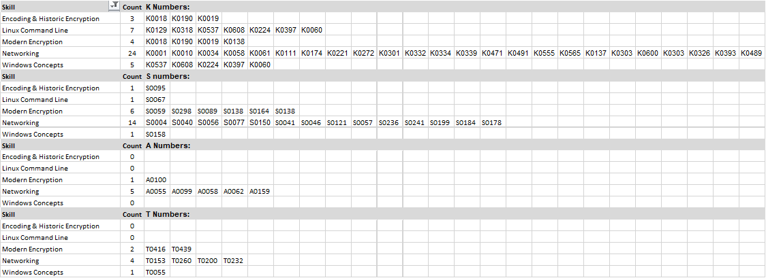
Technical Fundamentals

Slide 17
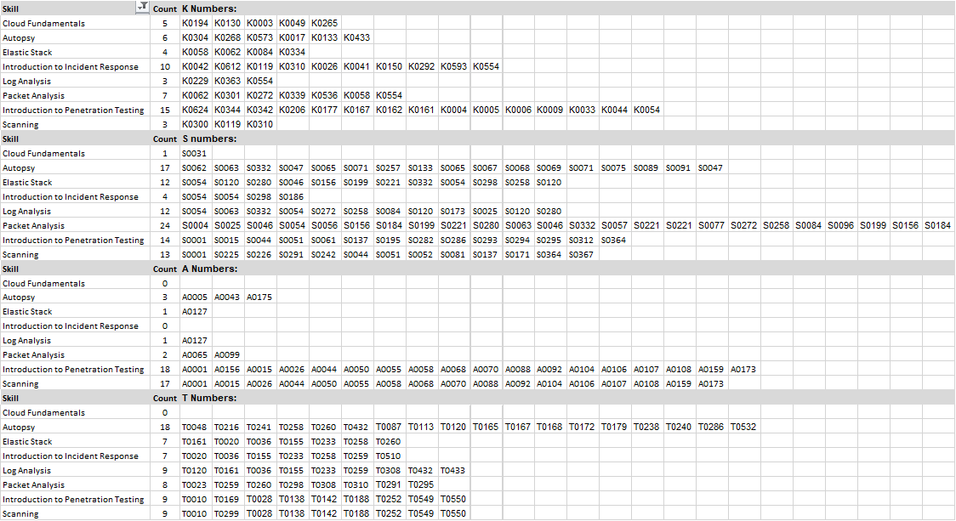
Career Foundations

Slide 18
Cyber Defense Analyst

Slide 19
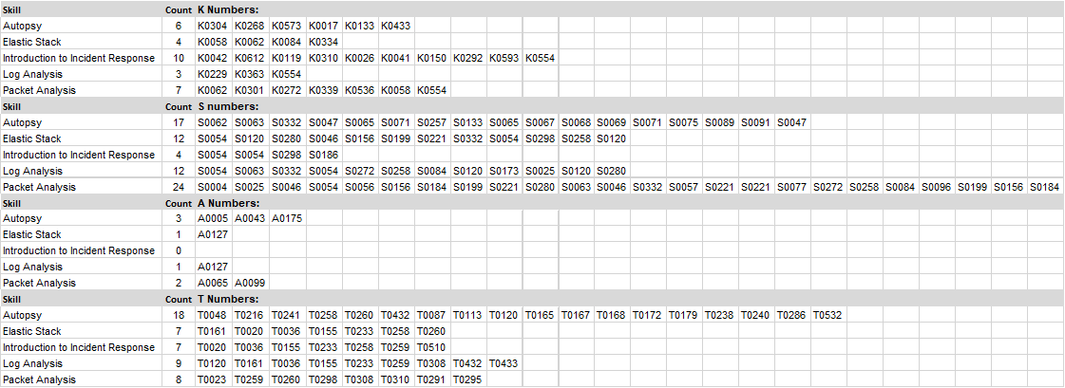
Cyber Defense Incident Responder

Slide 20
Systems Security Analyst

Slide 21
Vulnerability Assessment Manager

Slide 22
Appendix

Slide 23
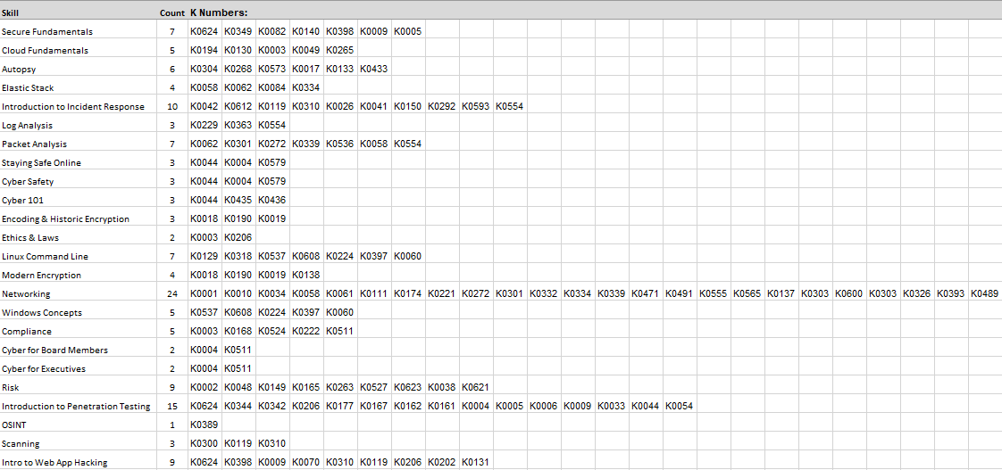
NICE Knowledge Areas (Link)

Slide 24
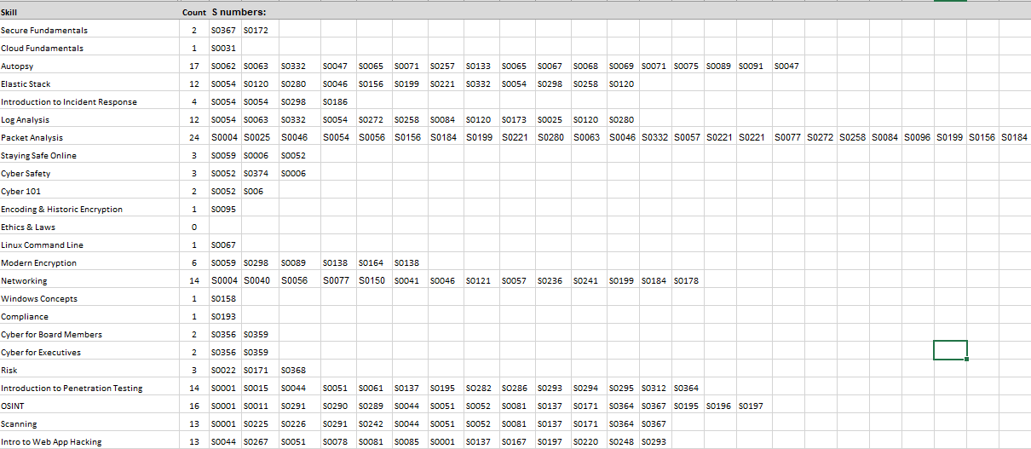
NICE Skills (Link)

Slide 25
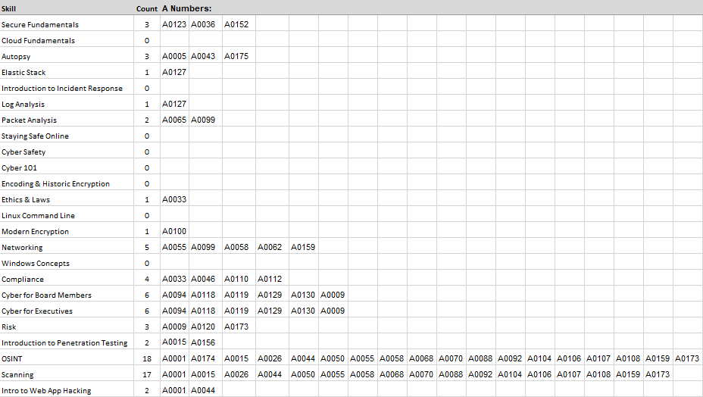
NICE Abilities (Link)

Slide 26
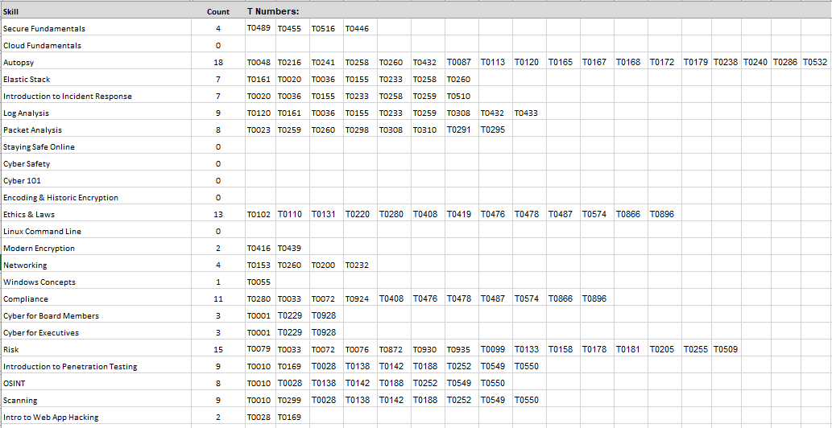
NICE Tasks (Link)

