Slide 1
Giving data a home and you the keys.

Slide 2
Mission
“We know first hand the trauma of loss and the burden of the associated processes in dealing with death. We know we can take away some of the pain for the families and those that serve them.”

Slide 3
What is PlotBox?
PlotBox is a cloud based death care management solution that facilitates cemeteries & crematoria in operating to world class standards.

Slide 4
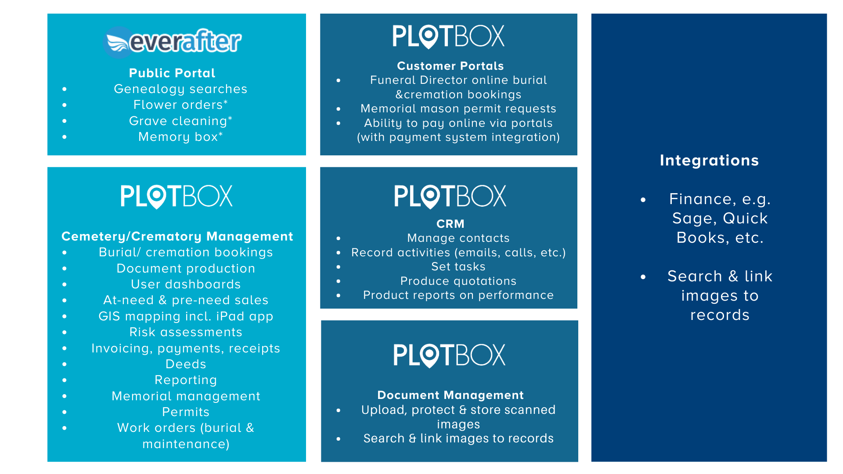
System Overview

Slide 5
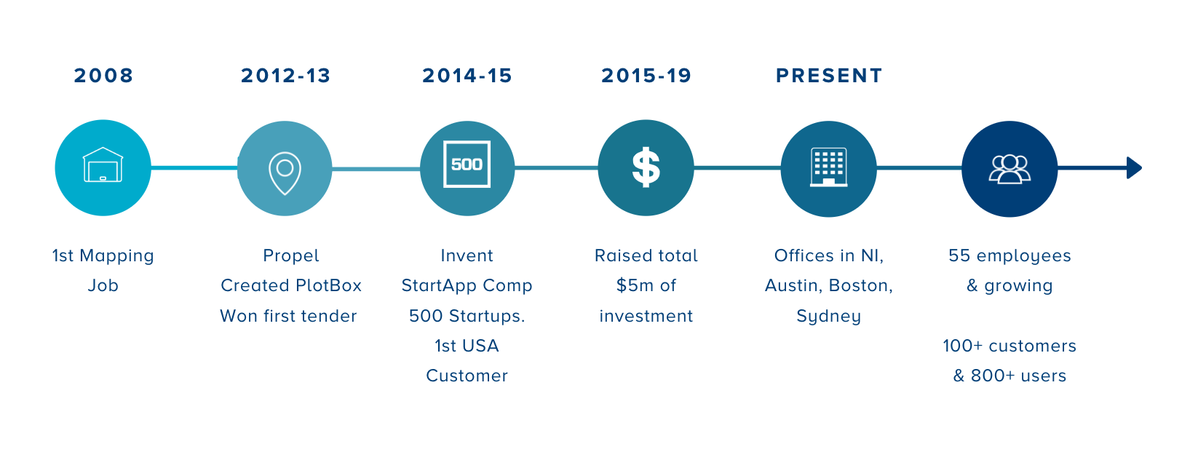
The Journey

Slide 6
Team Plotbox 2019

Slide 7
USA: Why and How?

Slide 8
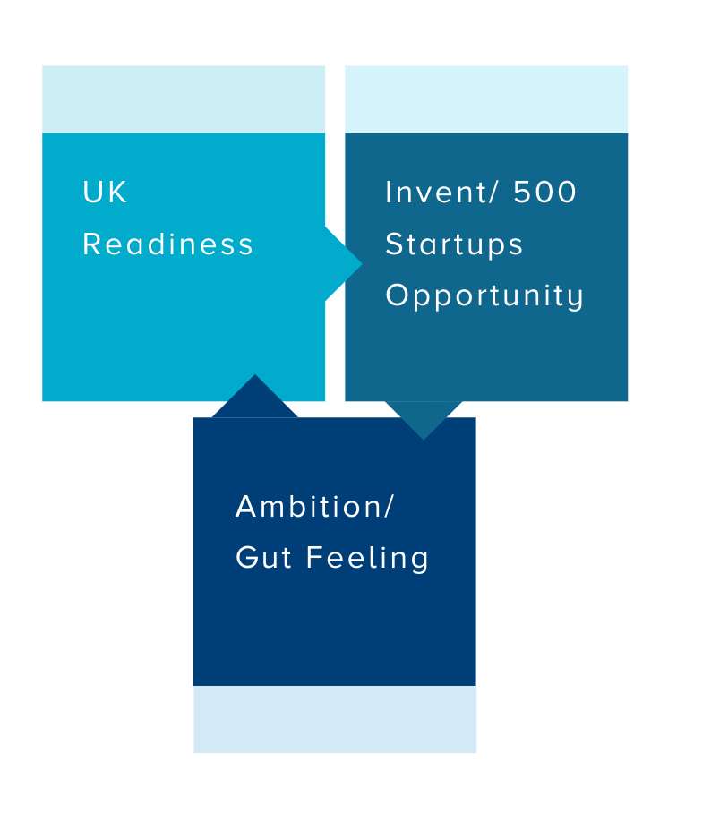
Why USA?

Slide 9
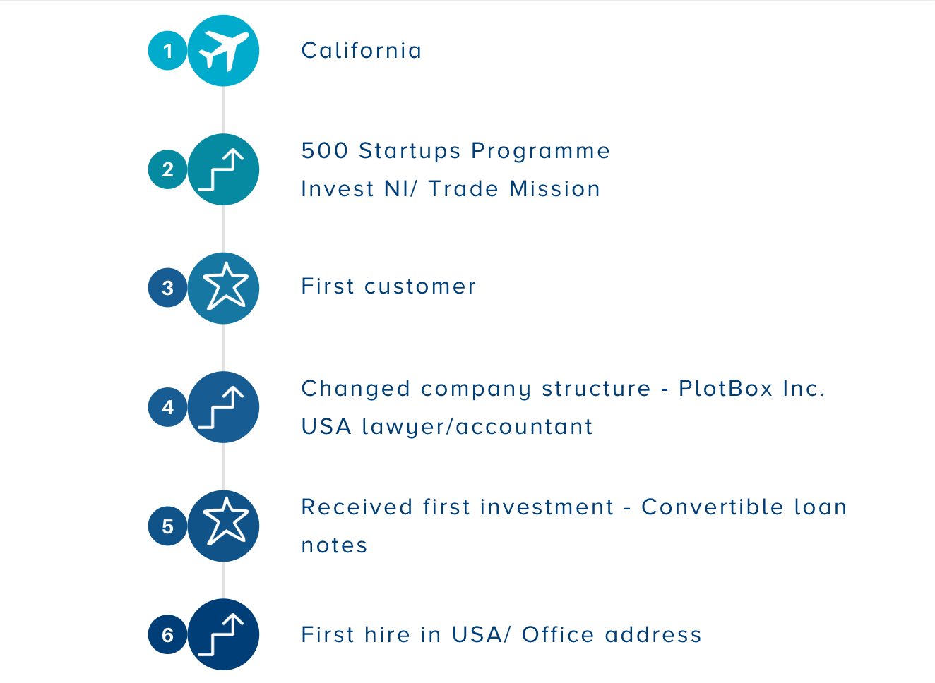
First Steps

Slide 10
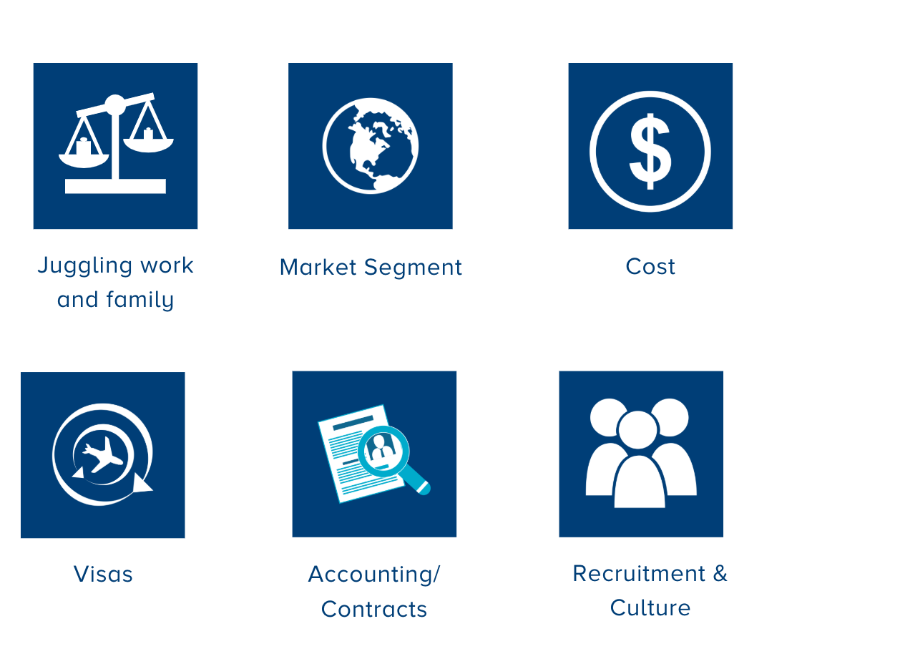
Challenges

